Slide 1


Austin Housing Market
Predictions
Presented by:
Tushar Muley

Slide 2
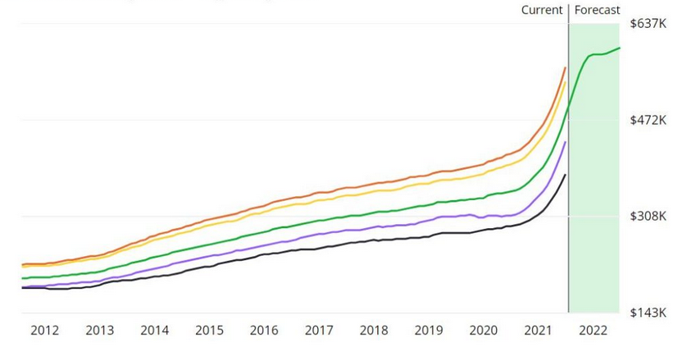
Austin Housing Market - Problem statement
Model prep, building, and evaluation to predict home prices
Focusing on the family unit homes
Newest Tech Hub
2

Slide 3
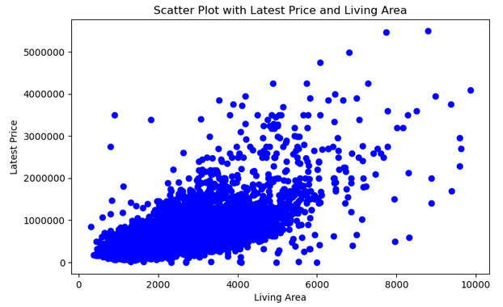
Austin Housing Market - EDA
Latest Price compared to Living Area

Slide 4
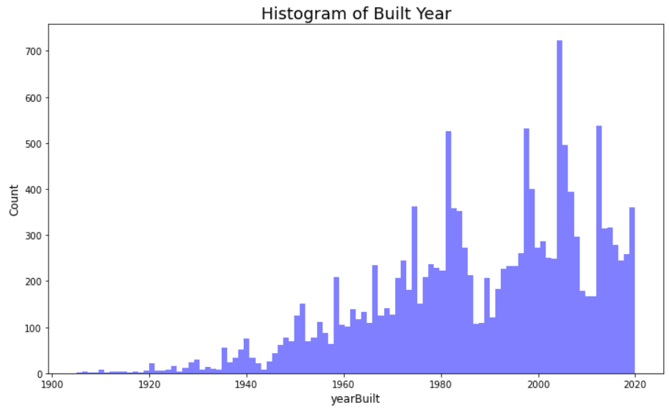
Austin Housing Market - EDA
Home sold by Build Year

Slide 5
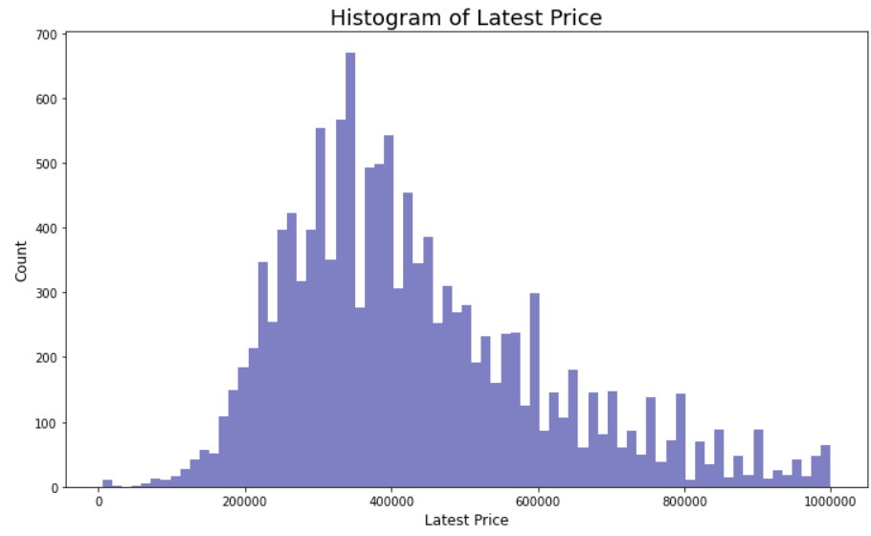
Austin Housing Market - Data Analysis

Slide 6
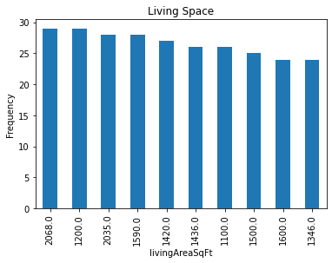
Austin Housing Market - Data Analysis
We can see that the average living square feet in home is a little greater than 2,000 sq ft. This is how we came up with our threshold on 4,000 sq ft for houses suited for families.

Slide 7
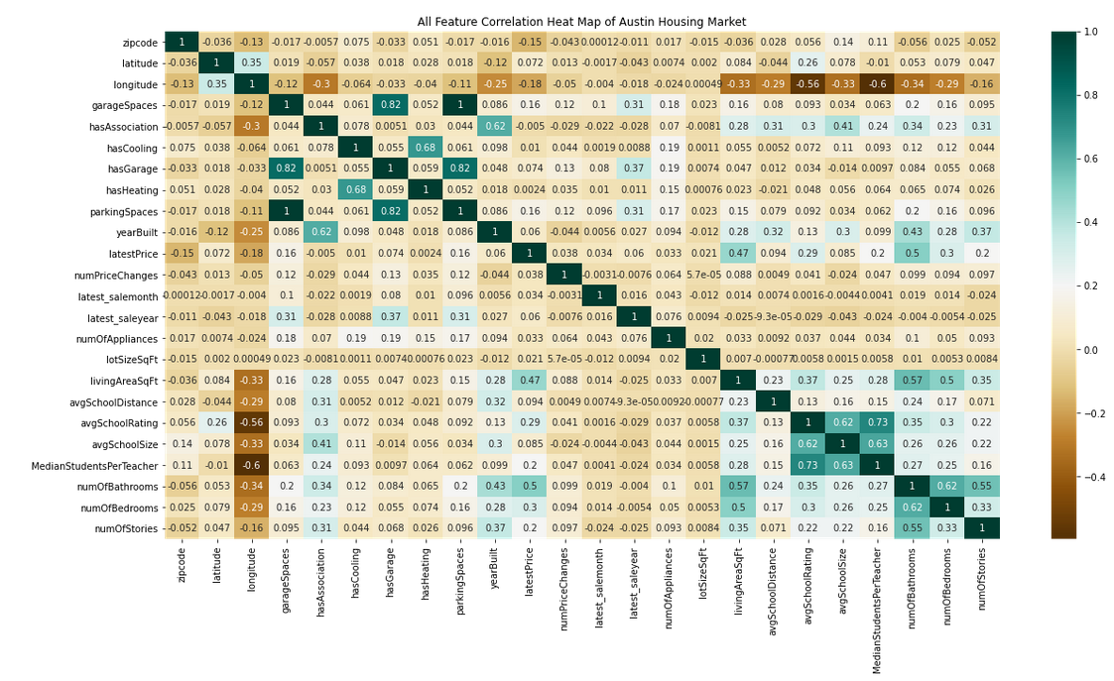
Austin Housing Market - Correlation Matrix

Slide 8
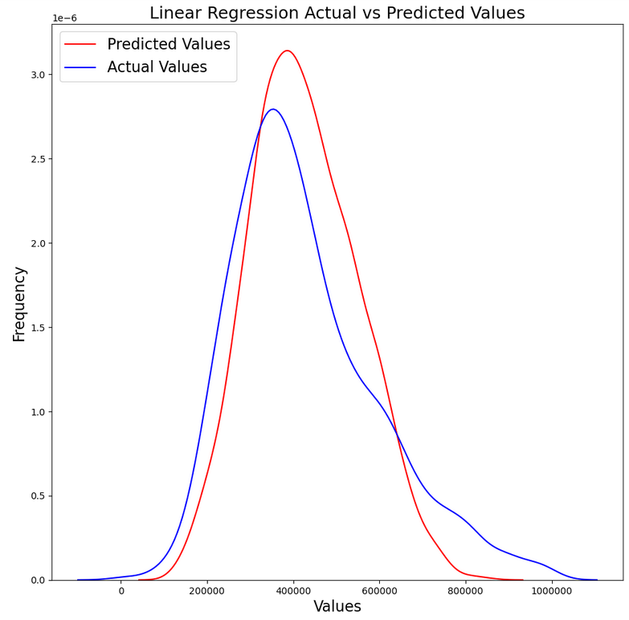
Austin Housing Market - Results
Linear Regression
R2 = 0.5291293289053352
MSE = 13513251704.429247
RMSE = 116246.51265491471
MAE = 86173.34851286063

Slide 9
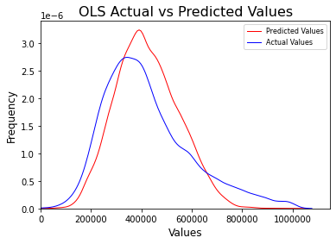
Austin Housing Market - Results
OLS Regression
R2 = 0.513
Adj, R2 = 0.512
F - Statistic = 454.7

Slide 10
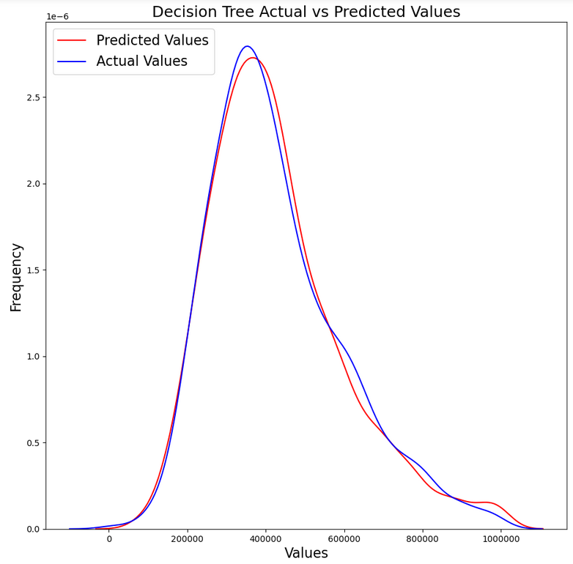
Austin Housing Market - Results
Decision Tree Regressor
R2 = 0.5843230640079228
MSE = 13733222233.081808
RMSE = 117188.83152025114
MAE = 79351.61472536034

Slide 11
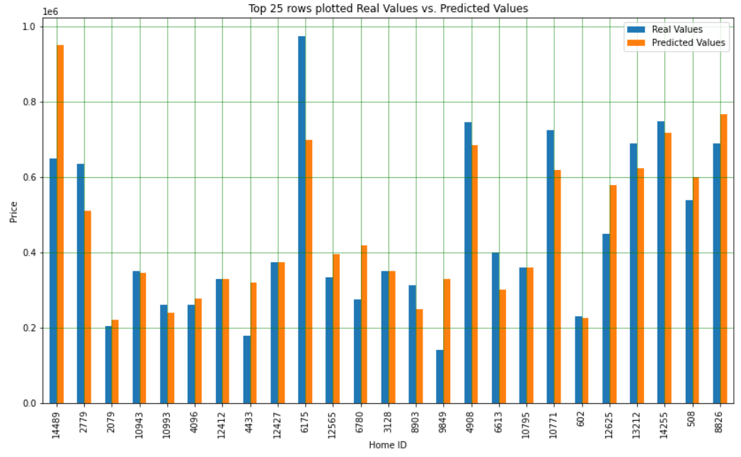
Austin Housing Market - Results
Top 25 Actual home prices and Predicted values

Slide 12
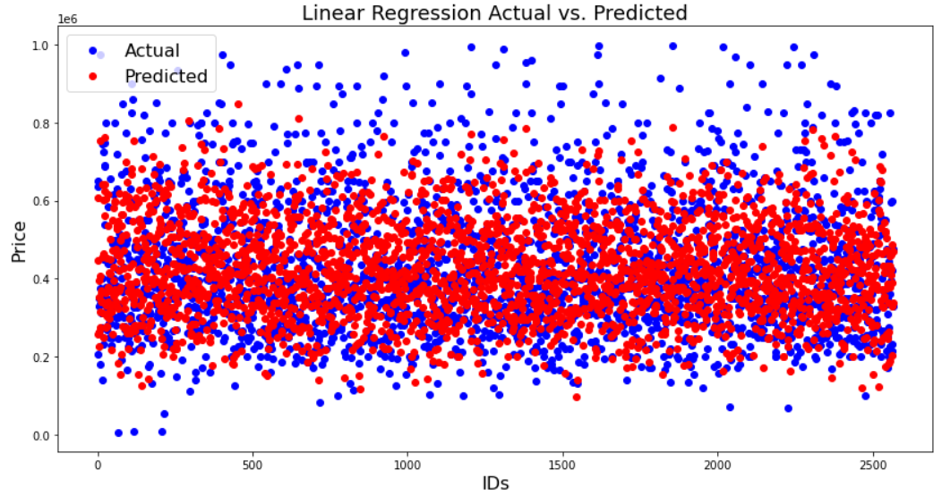
Austin Housing Market - Summary
Three different models where run for the Austin Housing sale price prediction
First model run idled only a 36% accuracy (Multivariable Linear Regression)
Final model achieved 58% accuracy (Decision Tree)
Model expectation was between 60% and 80%

Slide 13
Austin Housing Market - Post Mortem
Modeling - Ensemble
Splitting the data into more categories
More locations due to bids
Features in that home that are not in our data - Appraisals could be outdated

Slide 14
THANK
YOU.

Slide 15
Austin Housing Market - Reference
Austin, TX House Listings. (2021, April 12). Kaggle. https://www.kaggle.com/ericpierce/austinhousingprices?search=home+prices+&fileType=csv
Gates, B (2021, April 15). Austin’s median home price jumps nearly 29%, highest increase in nation. From kxan.com https://www.kxan.com/news/local/austin/austins-median-home-prices-jump-nearly-29-highest-increase-in-nation/
Startup Software Engineer Salary in Austin, Texas. From Salary.com
https://www.salary.com/research/salary/posting/startup-software-engineer-salary/austin-tx
Austin, Texas Average Home Prices. From Realtor.com
https://www.realtor.com/realestateandhomes-search/Austin_TX/overview
Zillow, https://www.zillow.com/

